Slide 1


Slide 2
Broken Link Hijacking

Slide 3
What is Broken Link Highjacking
Broken Link Highjacking (BLH) exists whenever a target links to an expired domain or page.

Slide 4
IMPACT/EXPLOITATION
Impersonation
When a company deletes their social media account they might forget to remove the link from their website. An attacker can create an account on the social media platform with that username and impersonate the company.

Slide 5
Example
Consider a Company named BigFish. The BigFish company website has social media links. Like Facebook, Twitter, Github.
Facebook= www.facebook.com/BigFish/
Gitbub=www.github.com/BigFish/
The company deleted the Github account but forgot to remove the link from the Company website.
This creates a broken link of Github in the website.

Slide 6
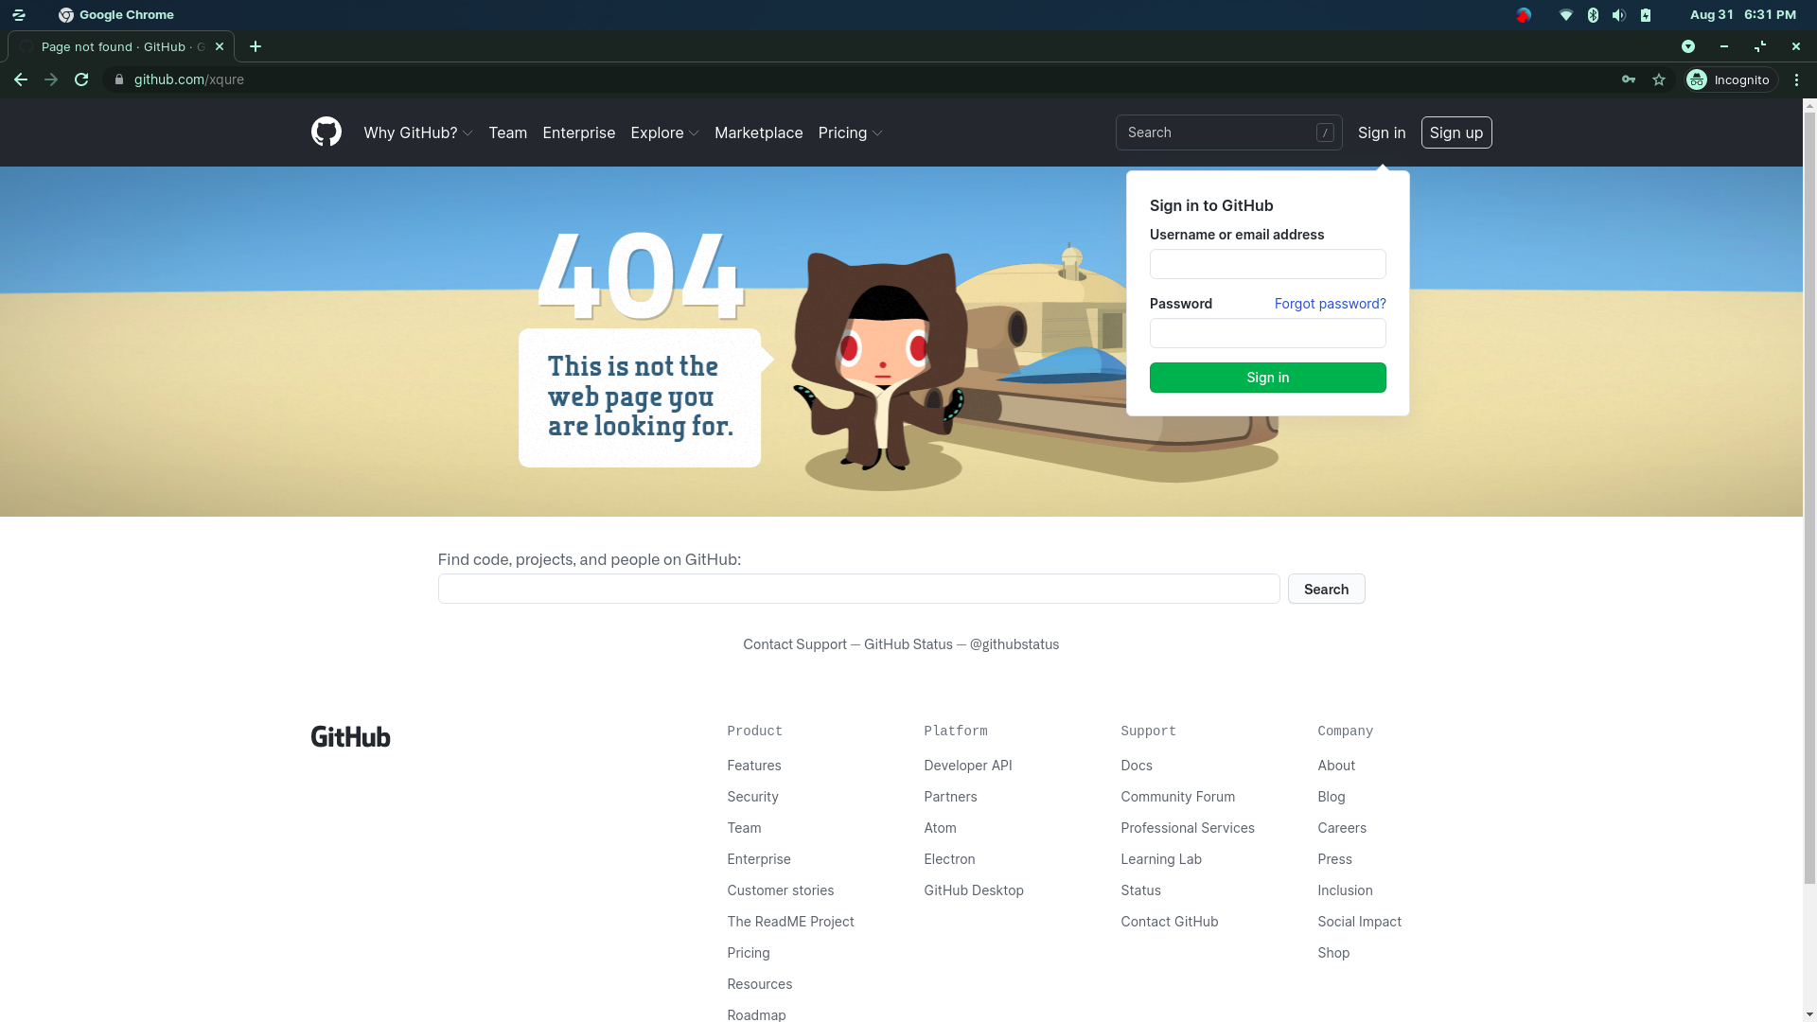
The Attack Scenario
The attacker finds this broken link.
Creates a account in the same name BigFish.
This allows a impersonation scenario.

Slide 7
Tools
www.brokenlinkcheck.com
Broken Link Checker- https://github.com/stevenvachon/broken-link-checker

Slide 8
THANK YOU

